Slide 1
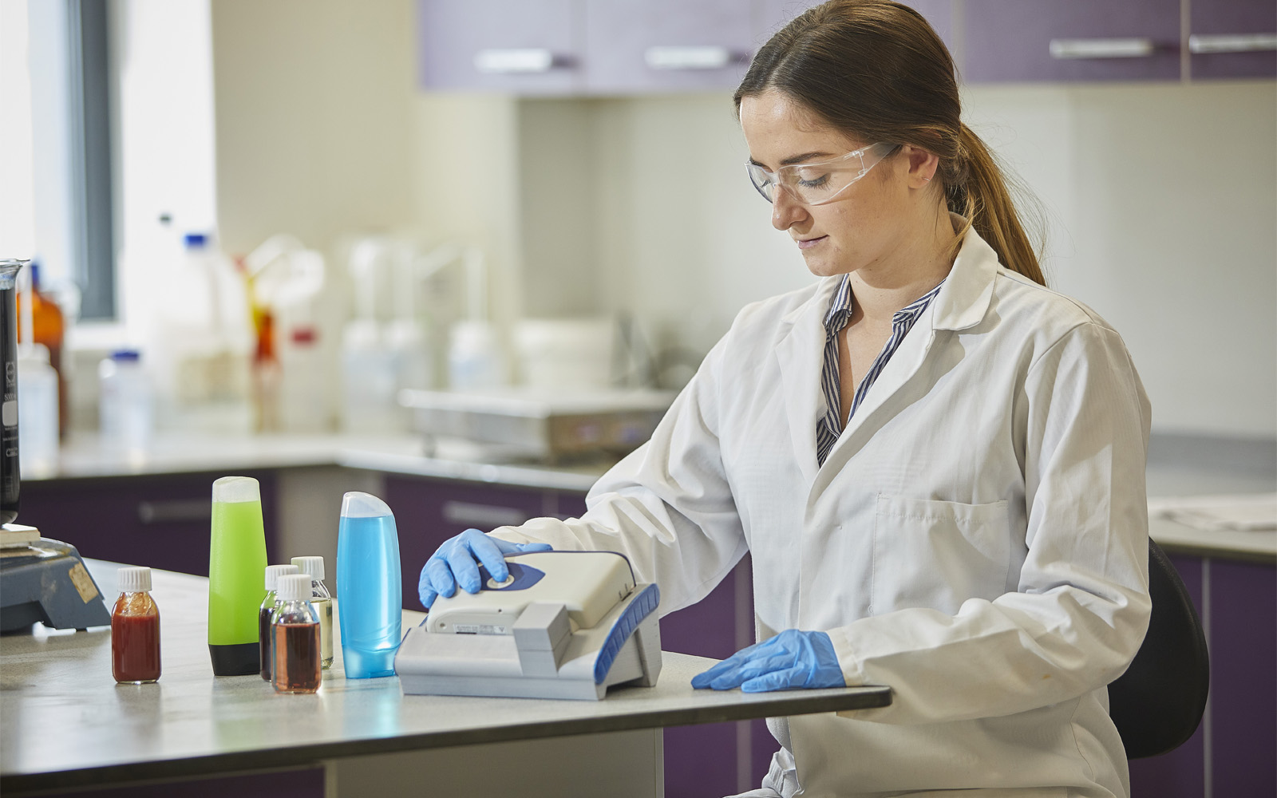
TR-Series Product Launch

Slide 2
What we will cover
Product overview and 'unboxing'
What's in it for you?
Competition Positioning
Value Proposition
Launch Pack

Slide 3
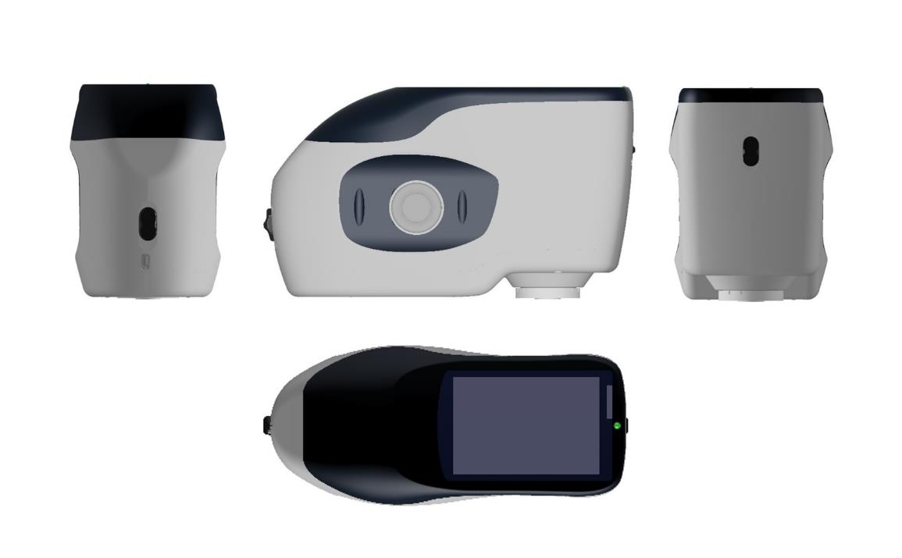
2019 Launched TR 520 & 500
Front
Side
Back
Top

Slide 4
TRA 520/500 Accessory

Slide 5
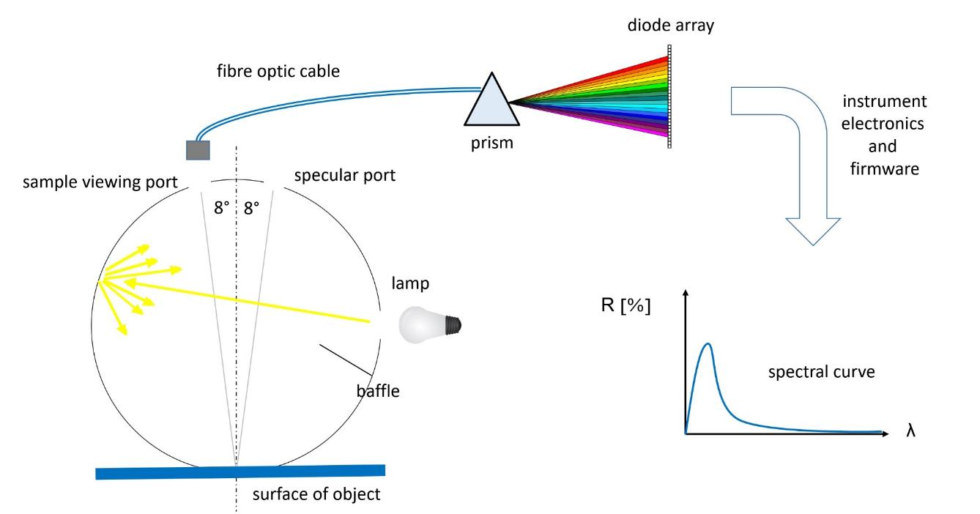
Sphere Spectrophotometer

Slide 6
Markets for Sphere Spectros
Paint and Coatings
Plastics
Food Colour Measurement
Building Materials
Durable Goods
White Goods
Life Sciences
Consumer Packaged Goods
Consumer Electronics
Ceramics
Cosmetic Manufacturers
Automotive
Textiles

Slide 7
2023 Launching TR 515
Front
Side
Back
Top

Slide 8
0°/45° (or 45°/0°) Geometry
white light from lamp
detector
reflected light from object
lamp
lamp
surface of object

Slide 9
45°/0° Circumferential
white light from lamp
Circumferential
Illumination
reflected light from object
Detector
Surface of object

Slide 10
Circumferential Illumination

Slide 11
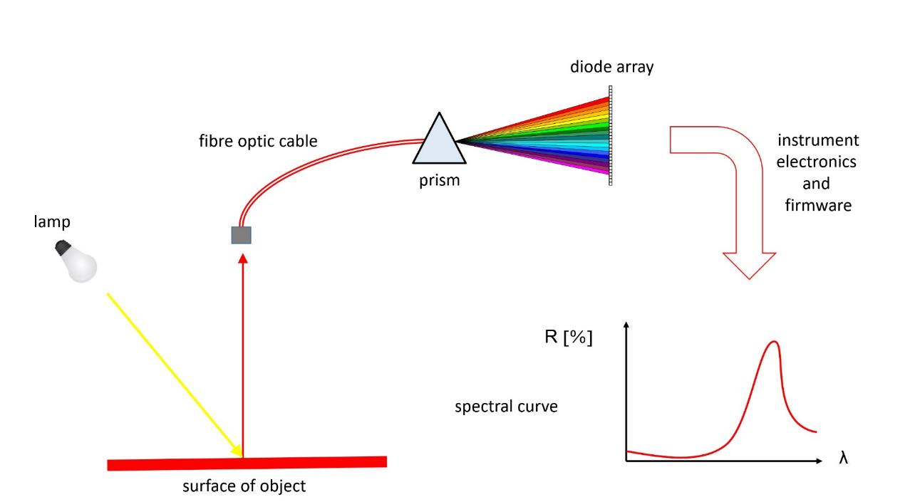
0°/45° (or 45°/0°) Spectro

Slide 12
Markets for 0°/45° Spectros
Consumer Packaged Goods
Consumer Electronics
Plastics
Ceramics
Print and Packaging
Automotive

Slide 13
Which instrument?
Sphere
0°/45°
Paint and Coatings
Food Colour Measurement
Building Materials
Durable Goods
White Goods
Life Sciences
Cosmetic Manufacturers
Textiles
Consumer Packaged Goods
Consumer Electronics
Plastics
Ceramics
Automotive
Print and Packaging

Slide 14
Web based Training
Basic Instrumentation
(Colour)
Accessories
(Liquids, gels & powders)
Web based Training
Mid Spec Handheld Instrumentation
(Colour & Gloss)
Accessories
(Liquids, gels & powders)
Simple QC Software
Onsite Training
High Spec Handheld Instrumentation
(Colour & Gloss)
Accessories
(Liquids, gels & powders)
Advanced QC Software
Objective
Benchtop Instruments
Networked QC Software
Formulation/Correction
Controlled Lighting
External Physical Colour Standards
(RAL, NCS, Pantone and Munsell)
Digital Colour Standards
Uncontrolled Lighting
Internal Physical Colour Standards
Subjective
Novice
Competent
Advanced

Slide 15
Web based Training
Basic Instrumentation
(Colour)
Accessories
(Liquids, gels & powders)
Web based Training
Mid Spec Handheld Instrumentation
(Colour & Gloss)
Accessories
(Liquids, gels & powders)
Simple QC Software
Onsite Training
High Spec Handheld Instrumentation
(Colour & Gloss)
Accessories
(Liquids, gels & powders)
Advanced QC Software
Objective
Benchtop Instruments
Networked QC Software
Formulation/Correction
Controlled Lighting
External Physical Colour Standards
(RAL, NCS, Pantone and Munsell)
Digital Colour Standards
Uncontrolled Lighting
Internal Physical Colour Standards
Subjective
Novice
Competent
Advanced

Slide 16
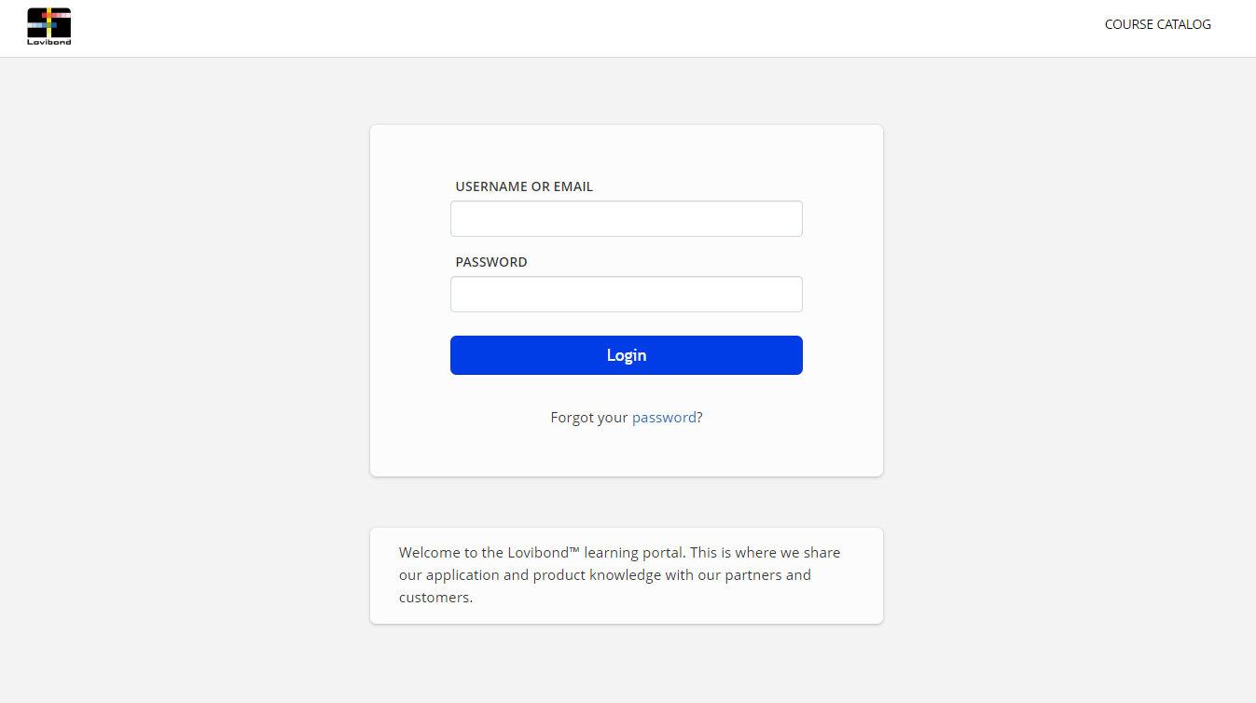
Novice- Web based Training
lovibond.talentlms.com

Slide 17
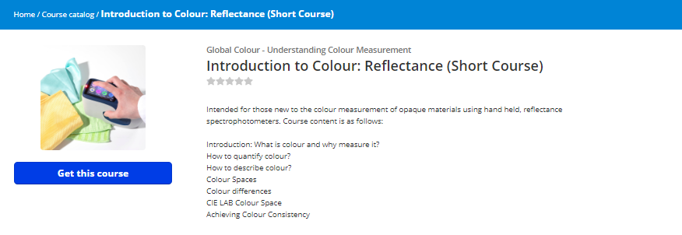
Novice- Web Training

Slide 18
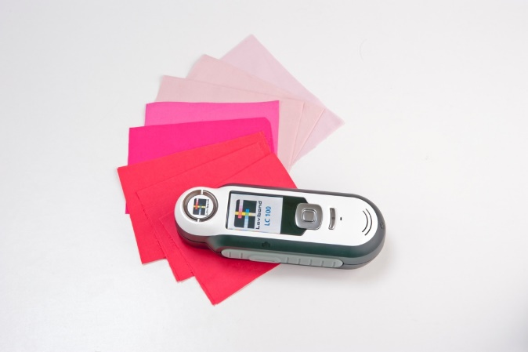
Novice- Basic Instrumentation
LC 100, Lovibond Spectrocolorimeter (401100)

Slide 19
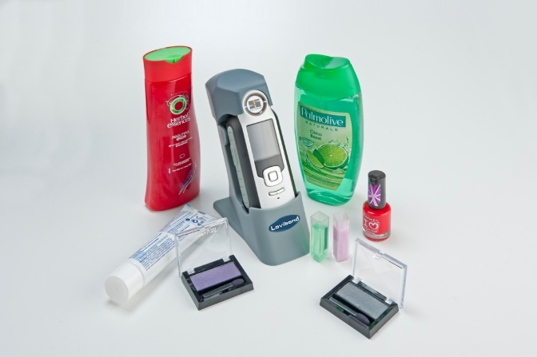
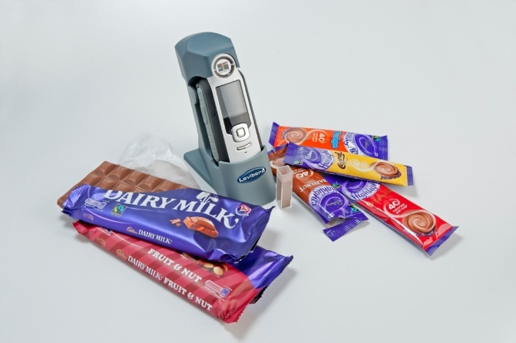
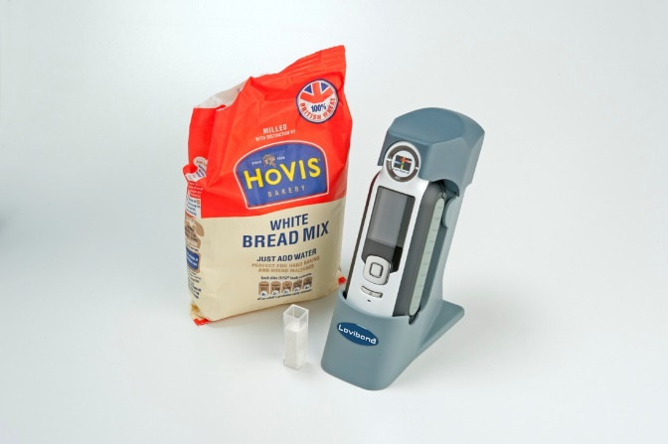
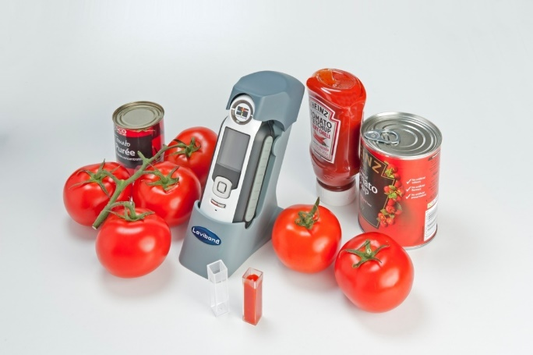
Novice- Accessories
LC100/SV100 Integrated Package (401120)

Slide 20
Web based Training
Basic Instrumentation
(Colour)
Accessories
(Liquids, gels & powders)
Web based Training
Mid Spec Handheld Instrumentation
(Colour & Gloss)
Accessories
(Liquids, gels & powders)
Simple QC Software
Onsite Training
High Spec Handheld Instrumentation
(Colour & Gloss)
Accessories
(Liquids, gels & powders)
Advanced QC Software
Objective
Benchtop Instruments
Networked QC Software
Formulation/Correction
Controlled Lighting
External Physical Colour Standards
(RAL, NCS, Pantone and Munsell)
Digital Colour Standards
Uncontrolled Lighting
Internal Physical Colour Standards
Subjective
Novice
Competent
Advanced

Slide 21
Competent- Web Training
lovibond.talentlms.com

Slide 22
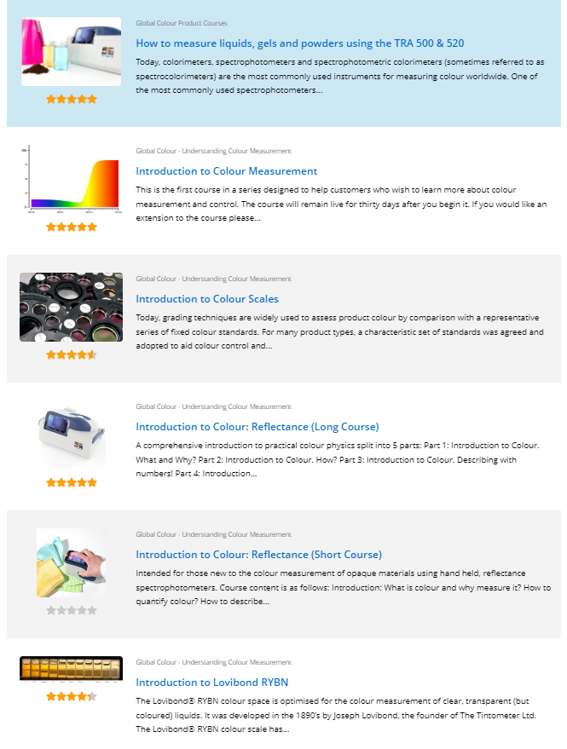
Competent- Web Training

Slide 23
Competent- Colour
TR 500 (403220)
Front
Side
Back
Top

Slide 24
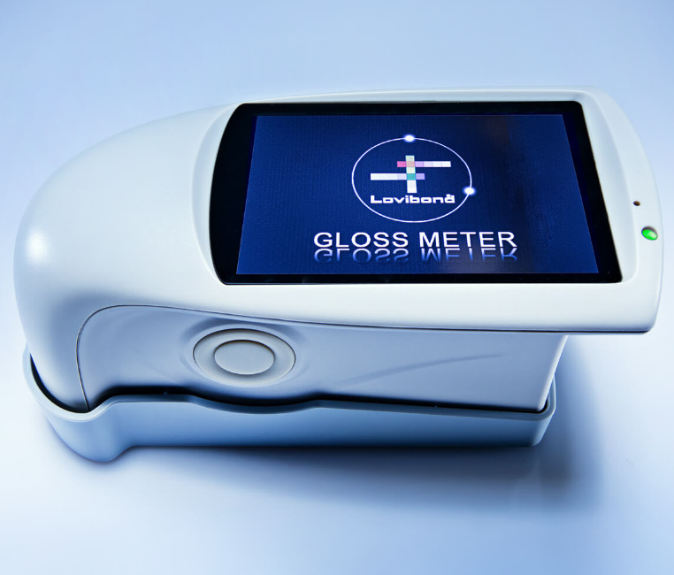
Competent- Gloss
TG 60 Gloss Meter (403050)

Slide 25
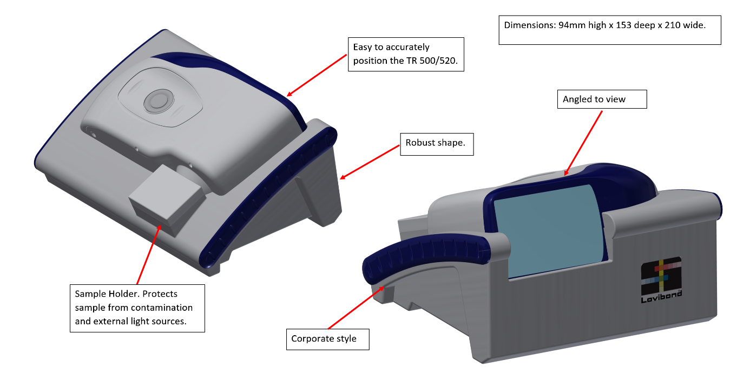
Competent- Accessories
TRA 500 (403220
)

Slide 26
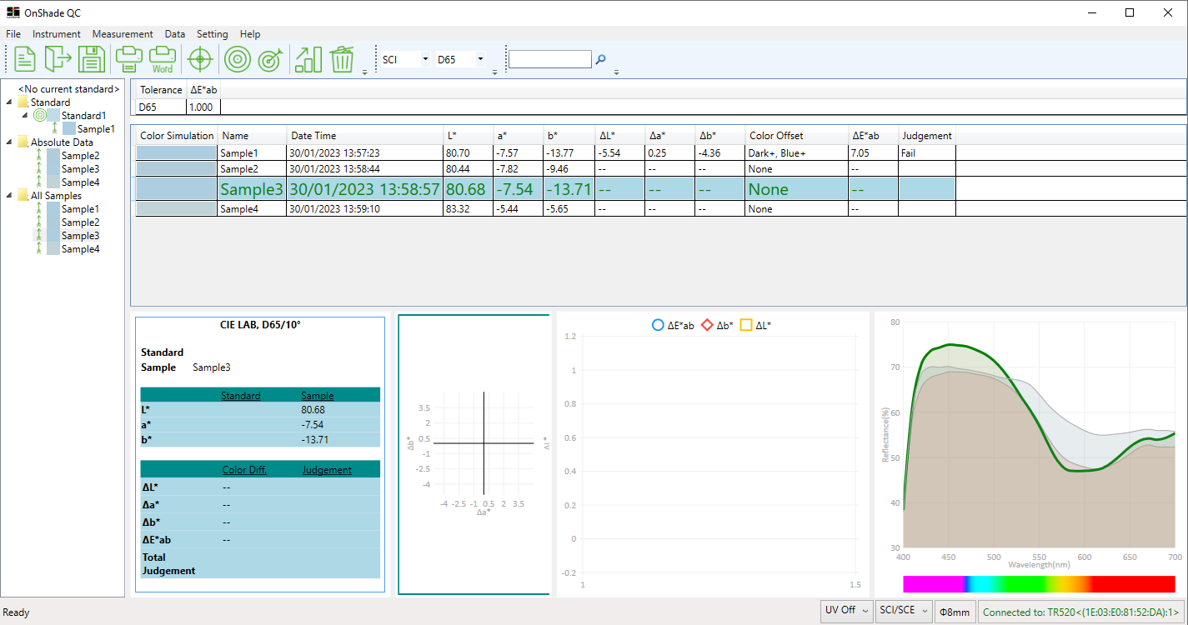
Competent- QC Software
OnShade QC (403065)

Slide 27
Web based Training
Basic Instrumentation
(Colour)
Accessories
(Liquids, gels & powders)
Web based Training
Mid Spec Handheld Instrumentation
(Colour & Gloss)
Accessories
(Liquids, gels & powders)
Simple QC Software
Onsite Training
High Spec Handheld Instrumentation
(Colour & Gloss)
Accessories
(Liquids, gels & powders)
Advanced QC Software
Objective
Benchtop Instruments
Networked QC Software
Formulation/Correction
Controlled Lighting
External Physical Colour Standards
(RAL, NCS, Pantone and Munsell)
Digital Colour Standards
Uncontrolled Lighting
Internal Physical Colour Standards
Subjective
Novice
Competent
Advanced

Slide 28
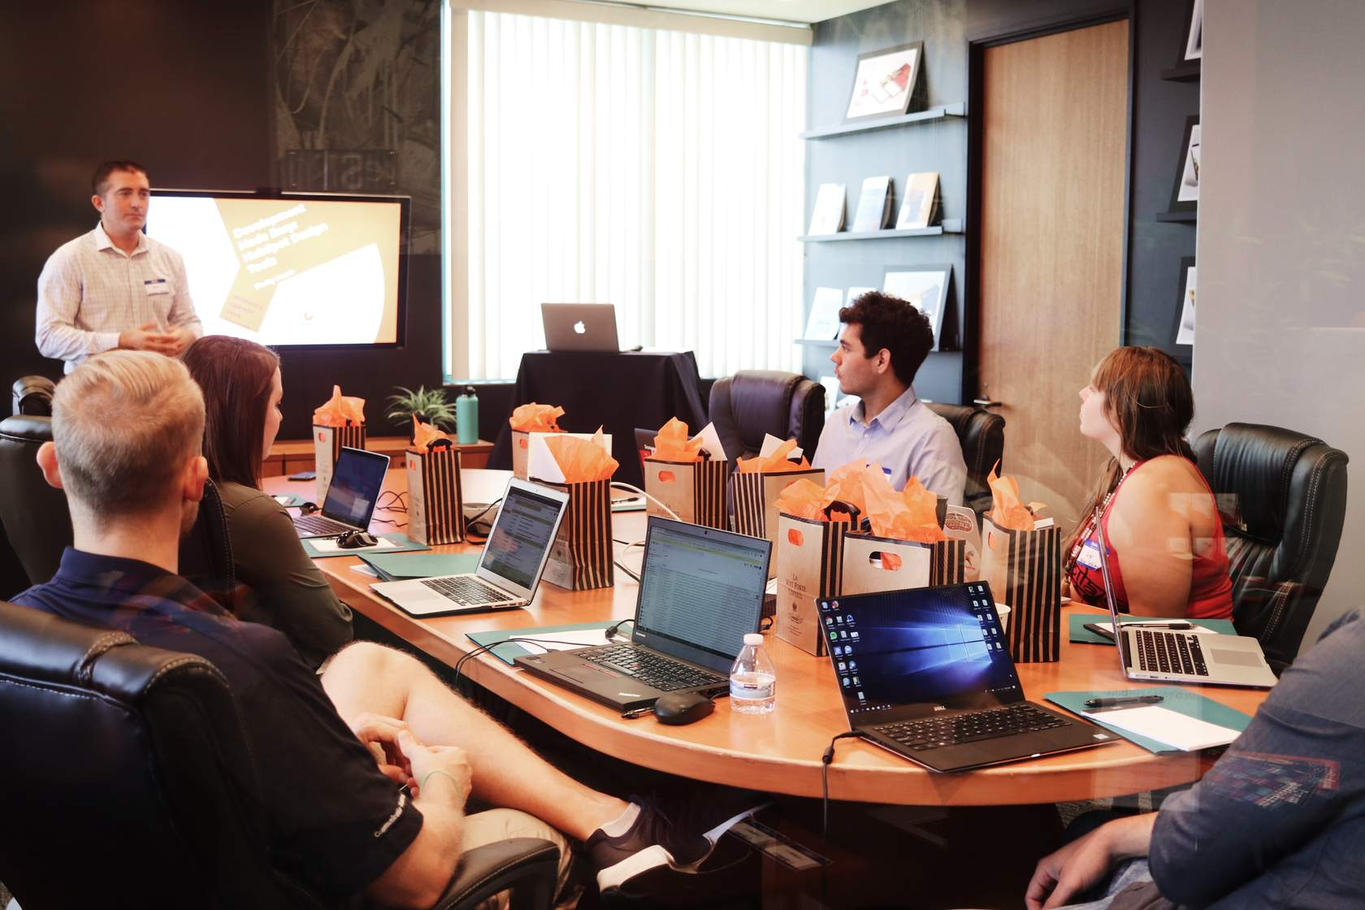
Advanced- Onsite Training

Slide 29
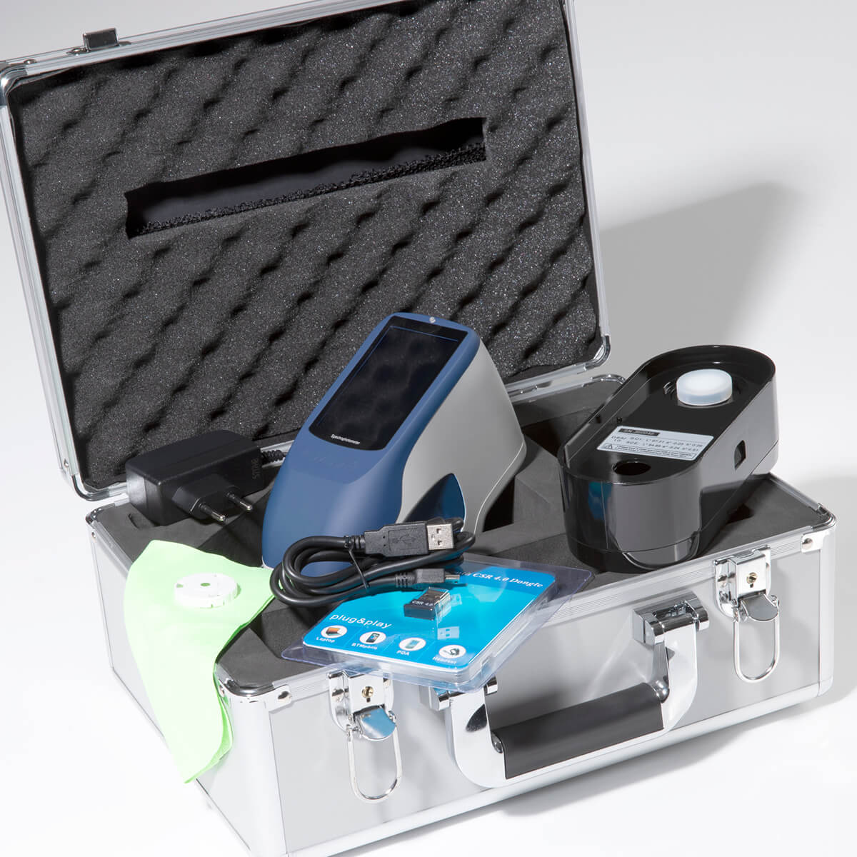
Advanced- Colour
TR 520 (403035) & TR 515 (403032)

Slide 30
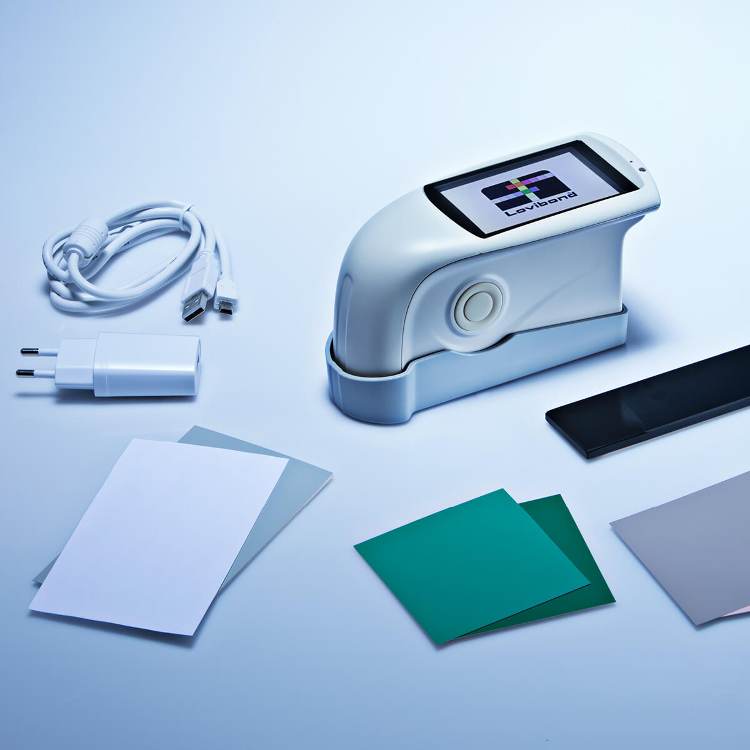
Advanced- Gloss
TG 268 Gloss Meter (403045)

Slide 31
Advanced- Accessories
TRA 520 (403225)

Slide 32
Advanced- QC Software
On-Colour Lite (400590) & Premium Software (400610)

Slide 33
2023 TR 5XX Series
TR 500 handheld, sphere (diffuse/8°), spectrophotometer.
*NEW* TR 515 handheld, 45°/0°, spectrophotometer.
TR 520 handheld, sphere (diffuse/8°), spectrophotometer.
TRA 500 & 520: TR5XX + Accessory

Slide 34
TR 5XX Spectrophotometers
Front
Side
Back
Top

Slide 35
Main Menu

Slide 36
Sample Measurement

Slide 37
FREE Onshade QC Software

Slide 38
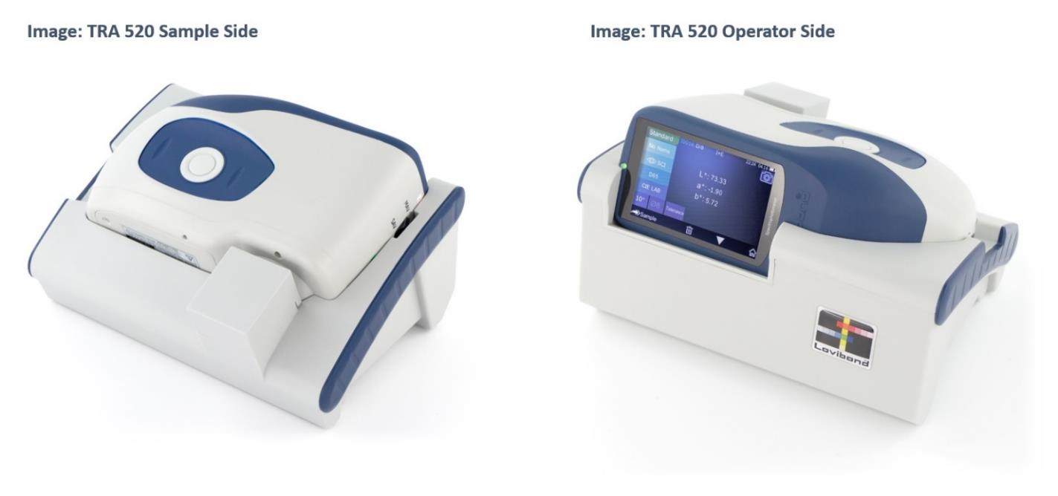
TRA 520/500 Accessory

Slide 39
TR 5XX “Live Demo”
What’s in the Box? (Live)
Calibration (Video)
Sample Measurement (Video)
Demo of Onshade Software (Video)

Slide 40
TR 5XX “What's in the Box?”
TR 5XX handheld Spectrophotometer.
OnShade Software (PC).
White & Black Calibration Board (white tile and black port).
USB Cable
External DC power supply.
USB Stick with User Manuals.
Sturdy Carrying Case.

Slide 41
TR 5XX Key Features
*New* Expanded Range: Sphere and 0°/45°
Ergonomic design improves handling
TFT LCD colour touch screen
Simple icon-based software
Camera-based locator means repeatable, stable readings
TR 500 fixed (8mm, 4mm or 1x3mm) area view
TR 520 and TR 515 allow interchangeable area views:
Large (10mm/8mm)
Small (5mm/4mm)
TR 520 and TR 515 UV in & UV out for Fluorescent materials.
Multiple language support
Accessories for powders, liquid, gel, paste, granules and solid materials
Free PC-based software (OnShade): graphs, statistical process control, shade searching, all your favourite colour spaces, colour differences & indices

Slide 42
What's in it for you?
Reflectance market offers a far larger potential that the transmittance
An opportunity to sell product and service to new customers
Simple to sell, market and support a class leading product at a lower price point

Slide 43
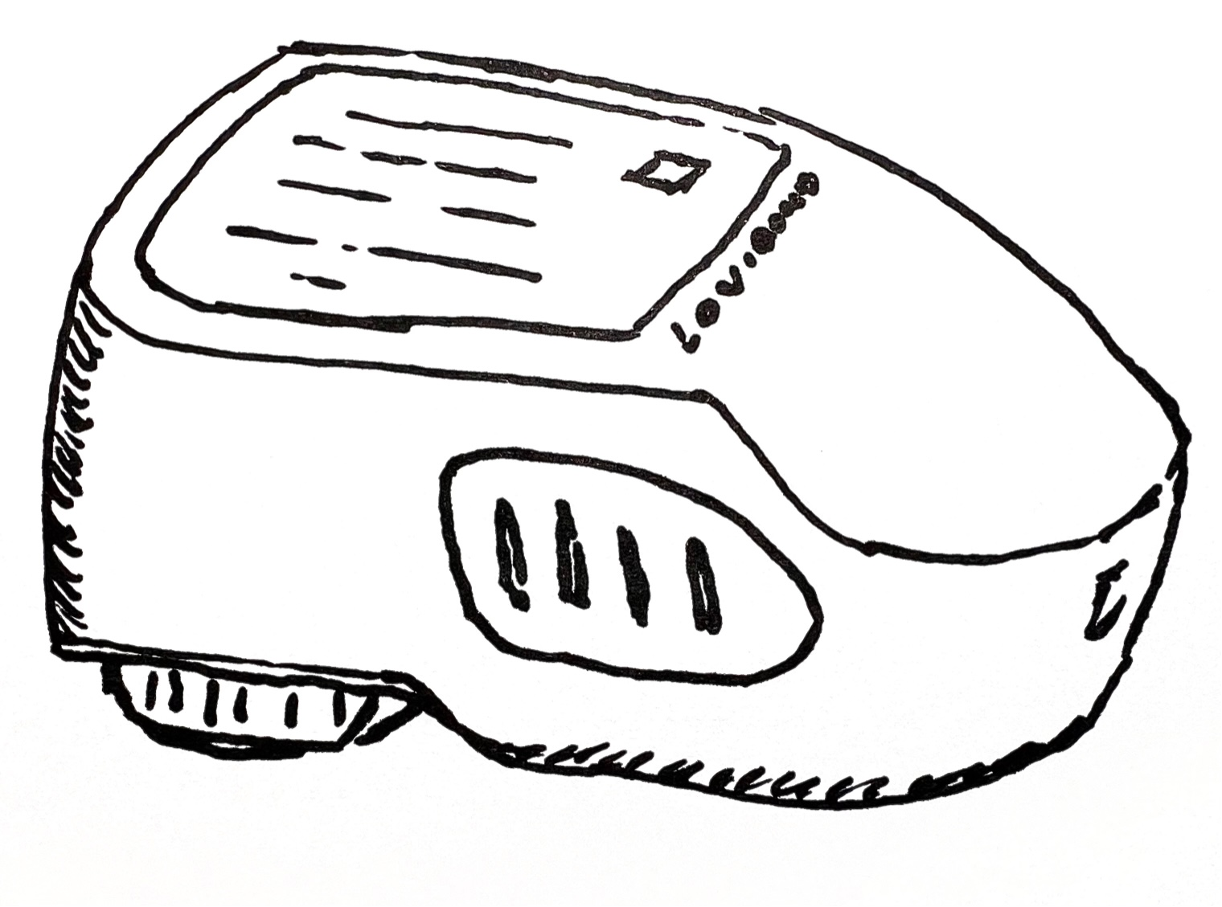
Sales Opportunity
Equipment Placement (lifespan 5-7 years)
Annual Service and Certification
+
€7,000 per unit sold
€1,000 per unit per year
= Expected Lifetime revenue €14000 per unit sold

Slide 44
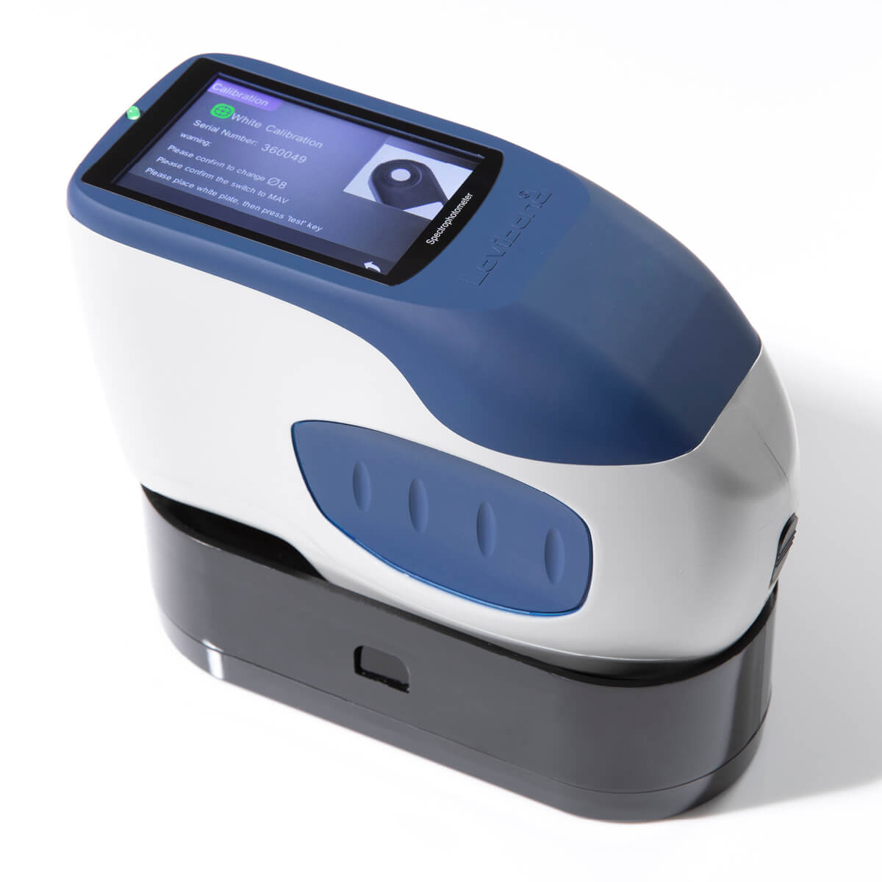
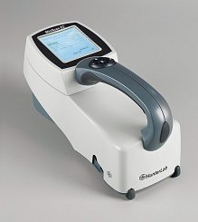
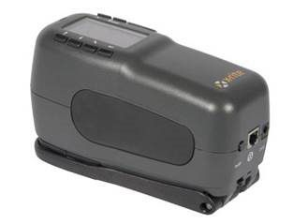
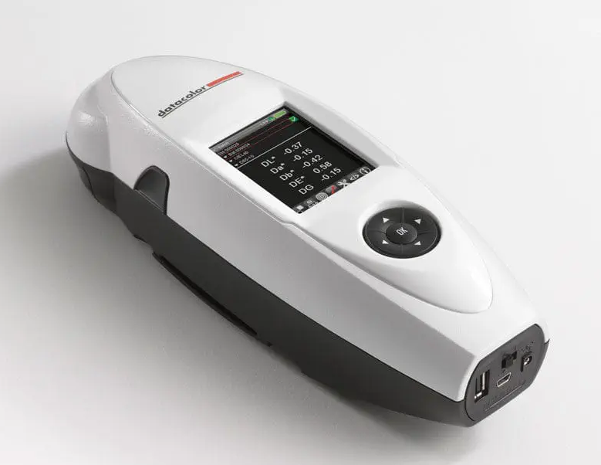
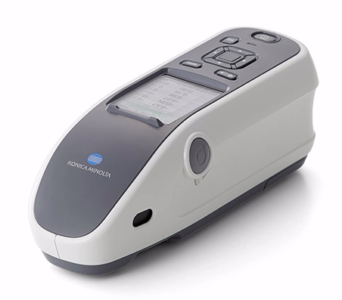
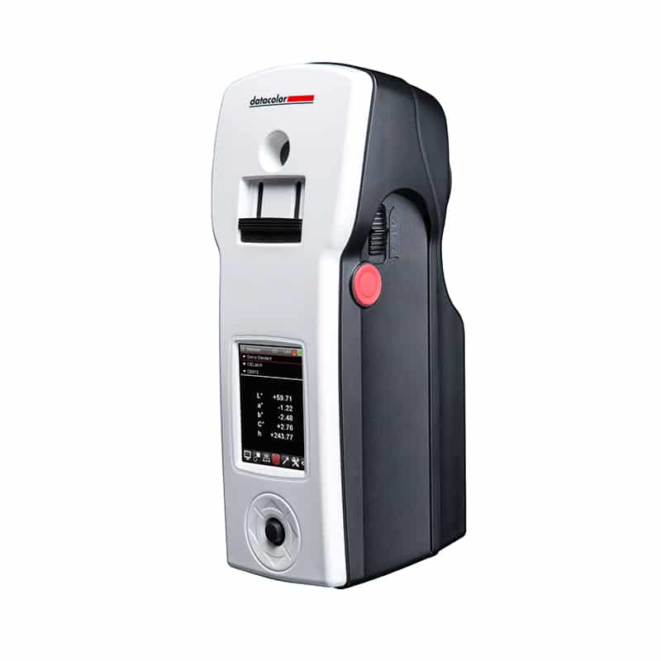
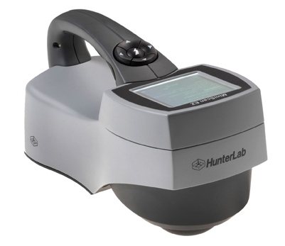
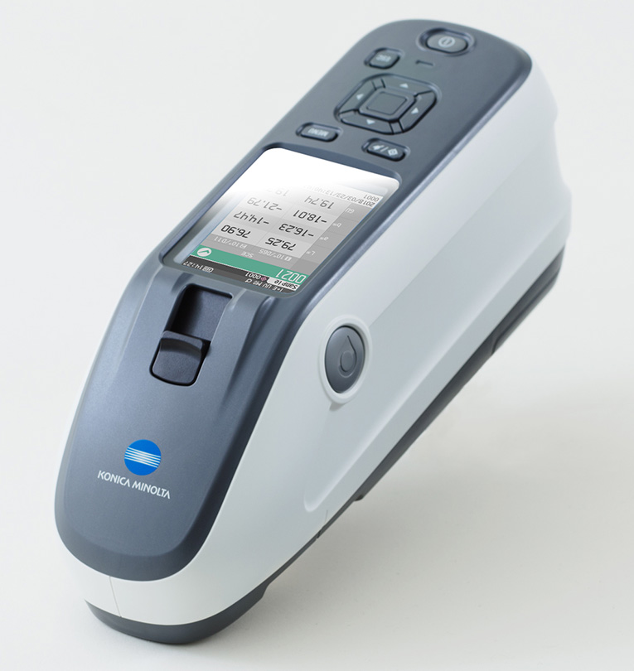
Competition Positioning
 | Lovibond | X-Rite | Datacolor | Hunterlab | BYK Gardener | Konica Minolta
Model List Price Free Software? | TR 515 €7,000 Yes | 964 €10,945 No | 45 €9,450 No | EZ 4500 €9,495 No | Spectro2go €10,995 No | CM25-cG €9,250 No
Model List Price Free Software? | TR 520 €7,000 Yes | CI64 €12,000 No | Check 3 €10,000 No | EZ 4000 €8,000 No | Spectro2guide € 12,995 No | CM26-cG €12,995 No

Slide 45
Unique Advantages
The TR-Series offer unrivalled value for money when packaged with local service provided by our trusted partners
The TRA Accessory Stand allows for measurement of not just solids but other materials; gels, pastes, powders
We have category leading technical features that offer real value to the customer… Eg Free OnShade Software

Slide 46
Potential Barrier to Sale?
Lovibond…Unknown brand in Reflectance Market
+
Our lower cost product
= Perceived Risk
How can we boost credibility and trust?
Focus on our strong Service & Support Network
Unique 3 year Limited Warranty
2 Years Standard plus an additional year at registration of product

Slide 47
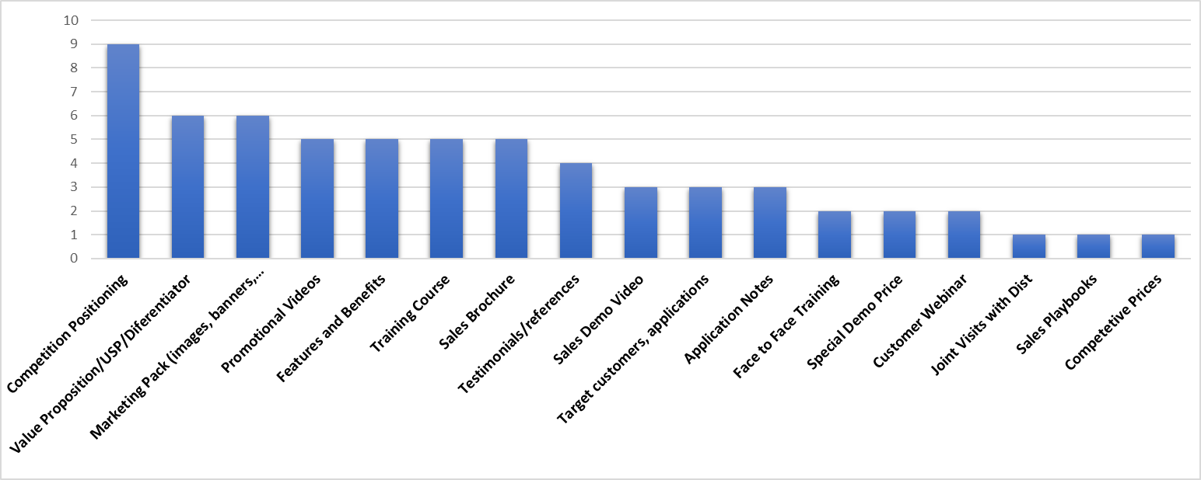
Sales Launch Pack
We asked you what you wanted:

Slide 48
Unique Advantages Summary
Lowest cost product in its class
Yet the product has class leading features
Supplied with advanced Onshade software free of charge
We have a worldwide Technical support Network through our trusted local Channel Partners
We are offering a unique 3 Year Warranty Period

Slide 49
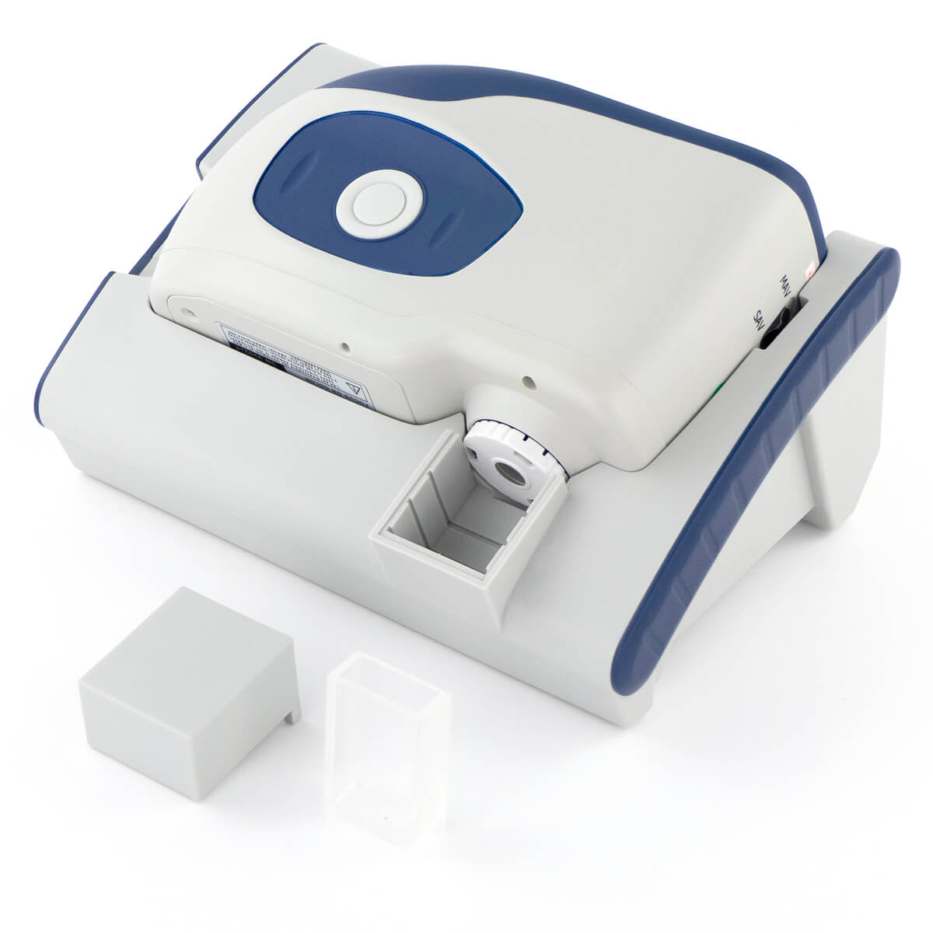
We Need You!
Take advantage of a one-time special offer of £2000 for any demo TR Series product
Next Steps…We will contact you to find out what your plans are to promote this product and what additional support you need

Slide 50
Q&A
Ask questions through the chat function

